Slide 1

Student Details
Name : Gayathri Mahalakshmi Nalluri Roll number : 22551A4631 College name : Godavari Institute of Engineering and Technology. College Mail I’d : nallurigayathri@gmail.com Personal Mail I’d : nallurigayathri@gmail.com

Slide 2
PROJECT TITLE/Problem Statement
Hiding a text inside an image steganography

Slide 3

AGENDA
Steganography is the practice of concealing information within another message or physical object to avoid detection. Steganography can be used to hide virtually any type of digital content, including text, image, video, or audio content. That hidden data is then extracted at its destination.

Slide 4
PROJECT OVERVIEW
Understand the principles of steganography and its applications.
Learn about digital image representation and pixel manipulation.
Develop a method to encode and decode secret text within an image.
Implement the Least Significant Bit (LSB) technique for steganography.
Ensure the imperceptibility of the hidden message to maintain the image's visual integrity.
Methodology :
Image Processing Basics
Least Significant Bit (LSB) Technique
Encoding Process
Decoding Process

Slide 5
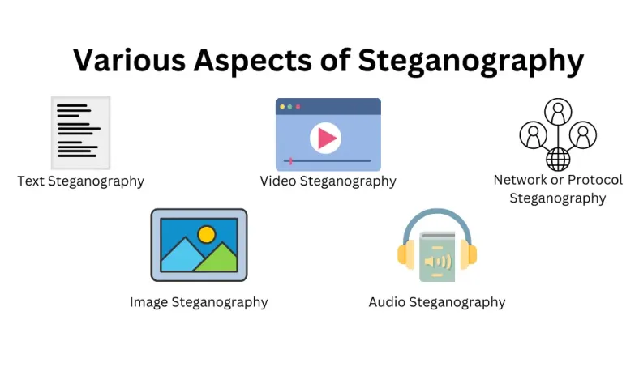
types of steganography :
Text steganography : It involves hiding information within text files in such a way that the presence of the hidden data is undetectable. Unlike cryptography, which scrambles the message, text steganography conceals the very existence of the message.
Image steganography : It involves hiding information within digital images in such a way that the presence of the hidden data is undetectable to the human eye. The goal is to embed secret messages in the image without altering its visual appearance.
Video steganography : It is the practice of hiding information within digital video files. It leverages the large size and high data redundancy of video files to conceal messages, making it difficult for unintended recipients to detect the hidden data.
Audio steganography : It involves hiding information within audio files. This can be achieved by manipulating audio signals in a way that is imperceptible to human ears but detectable by machines.

Slide 6
WHO ARE THE END USERS of this project? Encryption and Decryption
Decryption :
Decryption is the process of converting ciphertext back into plaintext using a decryption algorithm and a decryption key. The purpose of decryption is to make the encrypted data readable again, but only to those who possess the appropriate decryption key.
Ciphertext : ‘u2FsdGVkX19LcN14e5s4V8Up3zfjIfx7iV7dQ==‘
Decryption Algorithm : ASE (Advanced Encryption Standard)
Key : The same secret used for encryption
Plaintext : “Hello, World!”
Encryption :
Encryption is the process of converting plaintext (readable data) into ciphertext (unreadable data) using an algorithm and an encryption key. The purpose of encryption is to protect the confidentiality of data, ensuring that only authorized parties can access the original information.
Plaintext :”Hello, World!”
Encryption Algorithm : ASE (Advanced Encryption Standard)
Key : A secret key know only to the sender and receiver
Ciphertext : ‘u2FsdGVkX19LcN14e5s4V8Up3zfjIfx7iV7dQ==‘

Slide 7
Difference between Cryptography and Steganography
Cryptography
Steganography
Cryptography is the practice of securing information by transforming it into an unreadable format using mathematical algorithms. The main goal is to ensure the confidentiality, integrity, authenticity, and non-repudiation of data.
Steganography is the practice of hiding information within another non-secret medium in such a way that the existence of the information is concealed. The main goal is to hide the fact that communication is taking place.

Slide 8
YOUR SOLUTION AND ITS VALUE PROPOSITION : Steps are to convert the cover image to secret image
1. Choose an Image
Select an image that has enough pixels to accommodate the hidden text.
2. Encode the Text
Convert the text into a binary format and embed it within the image's pixels using a steganographic algorithm
3. Save the Image
Save the image with the hidden message. It will appear identical to the original image

Slide 9
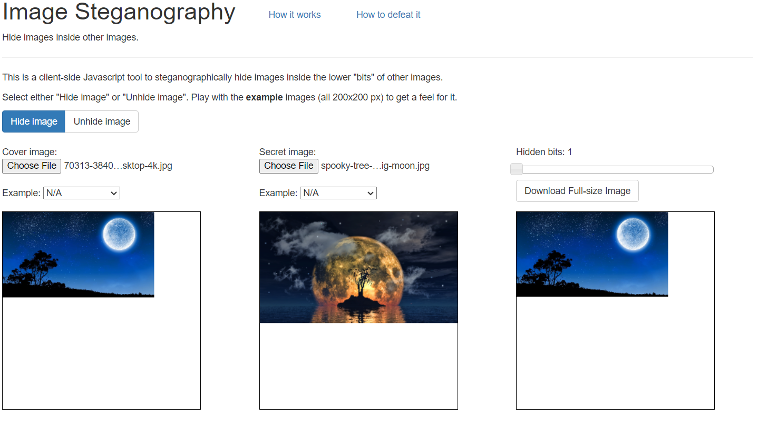
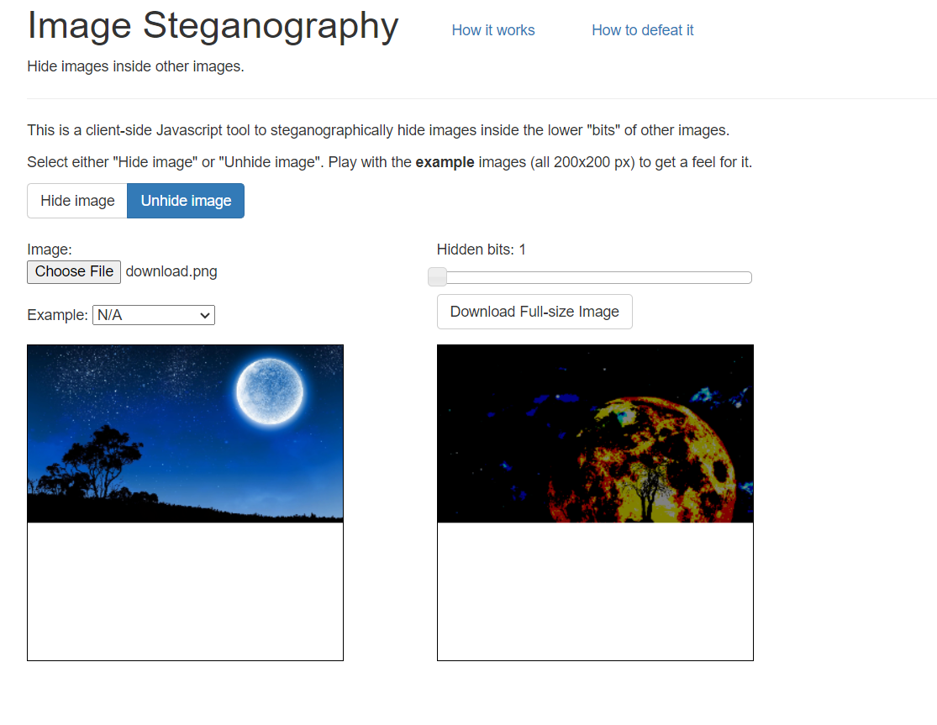
How did you customize the project and make it your own: The process we done to convert normal image into stenography

Slide 10
MODELLING
Data Security :
Steganography can be a valuable tool for protecting confidential information. It can hide data in plain sight, making it difficult for unauthorized individuals to detect and intercept the hidden messages
Digital Forensics :
Steganography is also used in digital forensics to uncover hidden evidence or information that might not be immediately apparent.
Ethical Considerations :
However, steganography can also be used for malicious purposes, such as hiding illegal or harmful content. It is essential to use steganographic techniques responsibly and ethically.

Slide 11

Results

Slide 12
links :
GitHub link :

Slide 13
THANK YOU
-Gayathri

